Slide 1
Analyzing the Impact of Car Features on Price and Profitability Swagatika SAMAL

Slide 2
Agenda
Introduction
Tech Stack used
About Dataset
Questionnaire & Approach
Key Insights
Conclusion

Slide 3

INTROduction

Slide 4
In the dynamic landscape of the automotive industry, marked by a relentless pursuit of fuel efficiency, environmental consciousness, and technological advancements, understanding the intricate drivers of consumer demand is paramount. With manufacturers vying for market share amidst evolving consumer preferences, a comprehensive comprehension of these demand dynamics has never been more crucial.
In this era witnessing a surge in electric and hybrid vehicles alongside a burgeoning curiosity in alternative fuel options like hydrogen and natural gas, the enduring dominance of traditional gasoline-powered cars persists. Against this backdrop, the task at hand for a Data Analyst is clear: How can a car manufacturer optimize pricing and product development strategies to not only meet consumer demand but also maximize profitability?
To address this inquiry, delving into the dataset becomes imperative. By scrutinizing the interplay between car features, market categorization, and pricing, insights can be gleaned to discern the most sought-after features and categories among consumers, as well as those most lucrative for manufacturers. Leveraging analytical tools such as regression analysis and market segmentation, a pricing strategy can be devised that strikes a harmonious balance between consumer preferences and profitability. Additionally, this analysis can pinpoint the product attributes deserving of heightened focus in future development endeavors.

Slide 5
TECH STACK USED

Slide 6
1. Jupyter NoteBook
2. Power BI
3. Microsoft Power Point

Slide 7
DATASET USED

Slide 8
The dataset encompasses details on more than 11,000 car models along with their respective specifications, covering information such as the make, model, year of release, fuel type, engine power, transmission, wheel type, number of doors, market category, size, style, estimated miles per gallon, popularity ranking, and manufacturer's suggested retail price (MSRP).
Titled "Car Features and MSRP," this dataset was compiled and shared on Kaggle by Cooper Union, a prestigious private college situated in New York City.
Outlined below is a concise summary of the dataset:
Number of observations: 11,159
Number of variables: 16
File type: CSV (Comma Separated Values)
The variables featured in the dataset include:
Make: Brand or manufacturer of the car
Model: Specific model designation of the car
Year: Year of the car's release
Engine Fuel Type: Type of fuel utilized by the car (e.g., gasoline, diesel) engine

Slide 9
Engine HP: Horsepower of the car's engine
Engine Cylinders: Number of cylinders in the car's engine
Transmission Type: Type of transmission (automatic or manual)
Driven_Wheels: Type of wheels driven by the car (front, rear, all)
Number of Doors: Quantity of doors present on the car
Market Category: Categorization of the car within the market (e.g., Luxury, Performance)
Vehicle Size: Size classification of the car
Vehicle Style: Stylistic designation of the car (e.g., Sedan, Coupe)
Highway MPG: Estimated highway miles per gallon for the car
City MPG: Estimated city miles per gallon for the car
Popularity: Ranking indicating the popularity of the car (based on views on Edmunds.com)
MSRP: Manufacturer's suggested retail price of the car

Slide 10
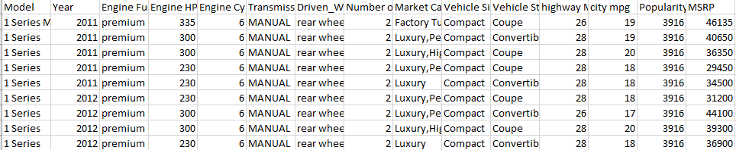
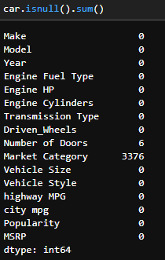
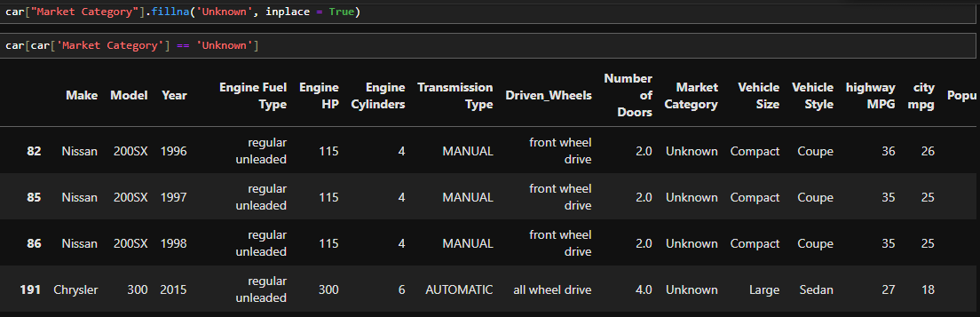
Sharing the screenshot of the dataset
Then I cleaned the dateset with imputing the null values with required value. I have found 3376 rows of “Market Category” has null values is been replaced with “Unknown”

Slide 11
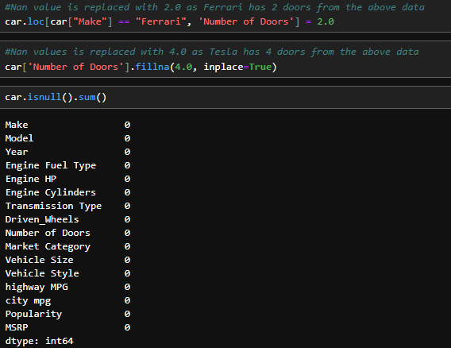
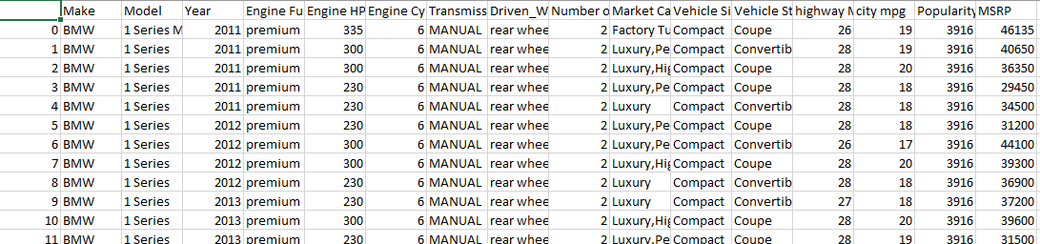
Then I replaced 6 rows of null values of “Number of Doors” with required value
The final dataset after EDA is car.csv

Slide 12
QUESTIonaire & APProach

Slide 13
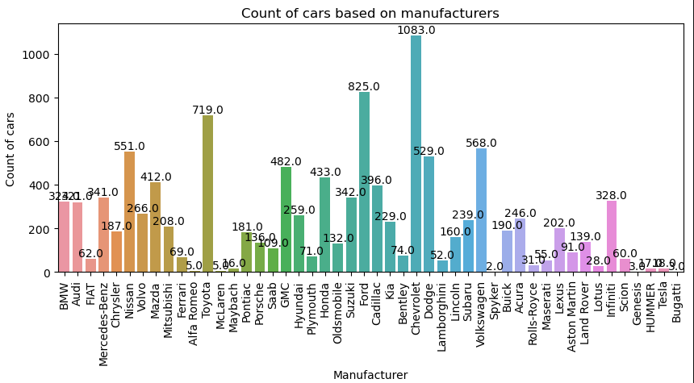
Task 1.A: Create a pivot table that shows the number of car models in each market category and their corresponding popularity scores. Task 1.B: Create a combo chart that visualizes the relationship between market category and popularity.

Slide 14
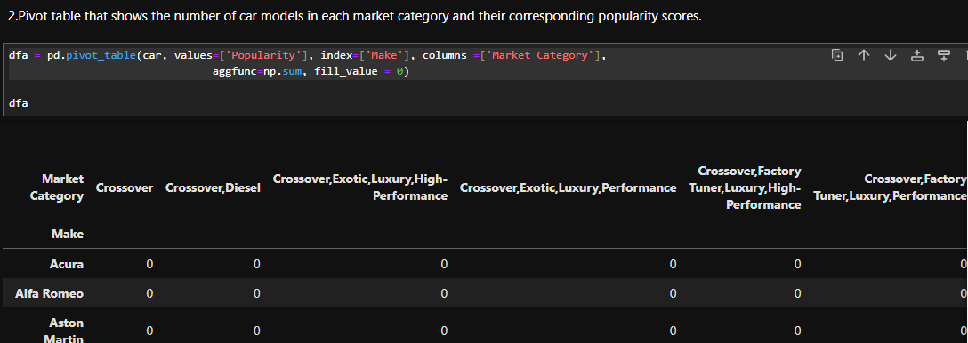
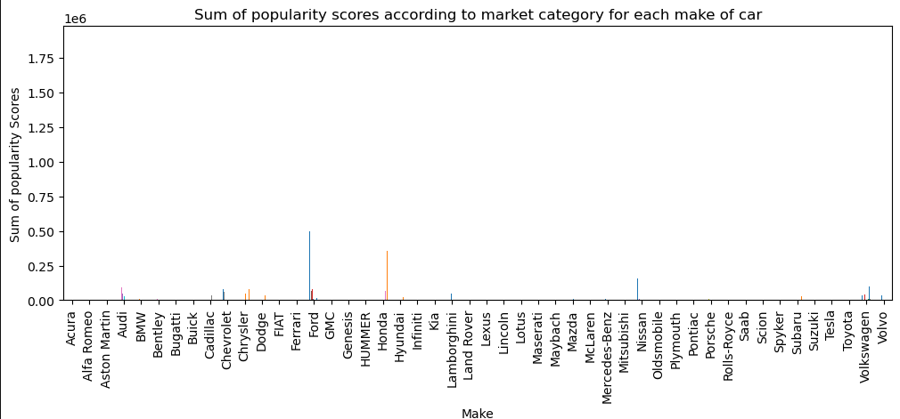

Slide 15
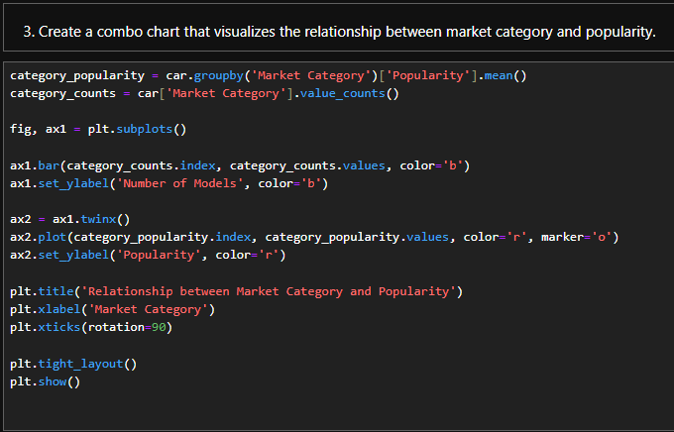
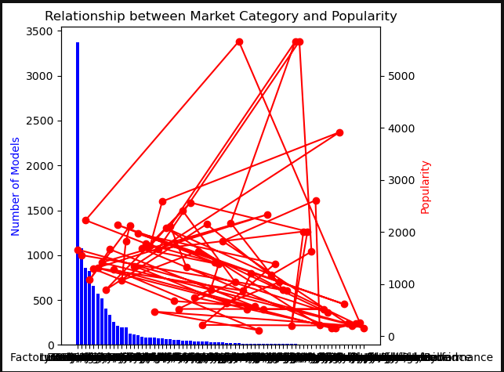

Slide 16
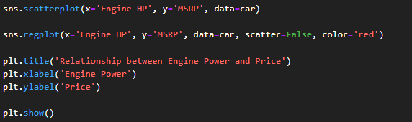
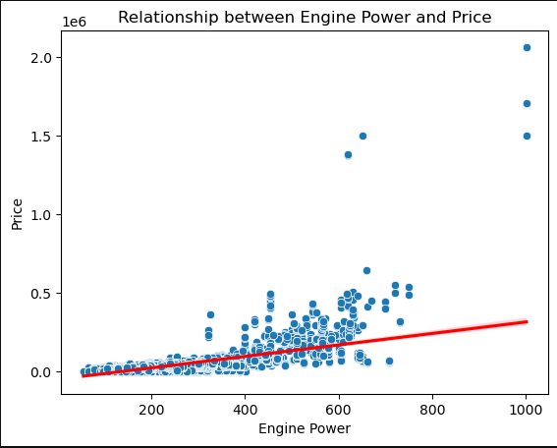
Task 2: Create a scatter chart that plots engine power on the x-axis and price on the y-axis. Add a trendline to the chart to visualize the relationship between these variables.

Slide 17
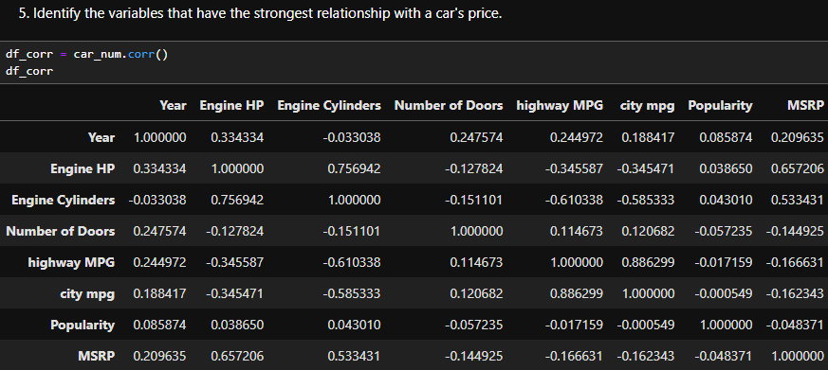
Task 3: identify the variables that have the strongest relationship with a car's price. Then create a bar chart that shows the coefficient values for each variable to visualize their relative importance. .

Slide 18
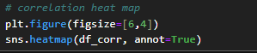
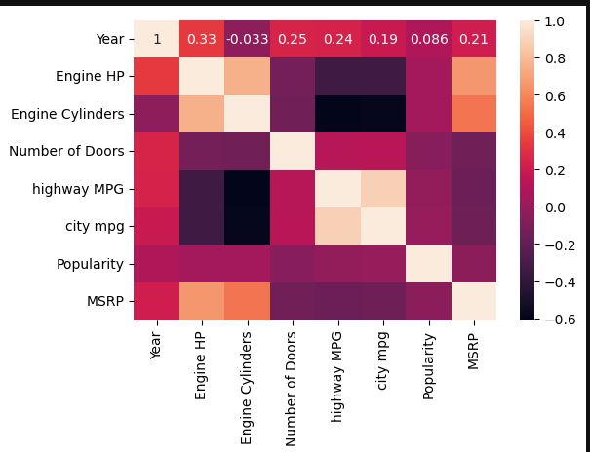

Slide 19
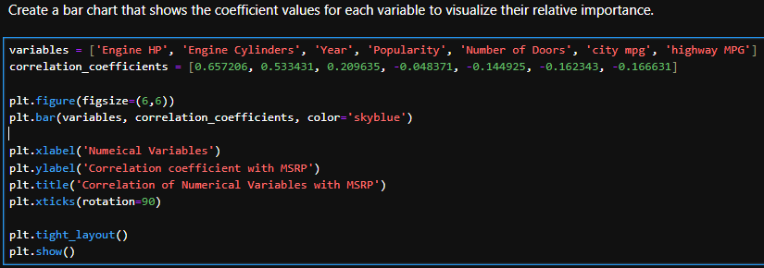
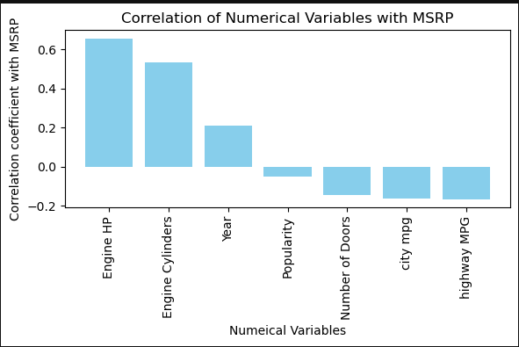

Slide 20
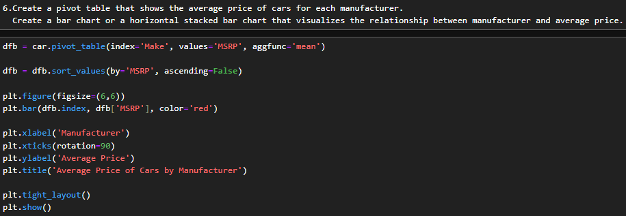
Task 4.A: Create a pivot table that shows the average price of cars for each manufacturer. Task 4.B: Create a bar chart or a horizontal stacked bar chart that visualizes the relationship between manufacturer and average price.

Slide 21
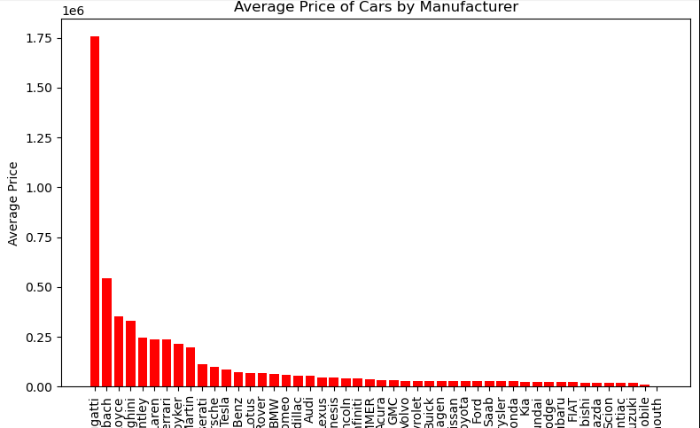

Slide 22
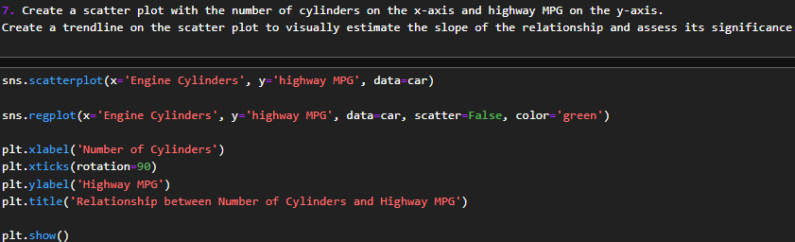
Task 5.A: Create a scatter plot with the number of cylinders on the x-axis and highway MPG on the y-axis. Then create a trendline on the scatter plot to visually estimate the slope of the relationship and assess its significance. Task 5.B: Calculate the correlation coefficient between the number of cylinders and highway MPG to quantify the strength and direction of the relationship.

Slide 23
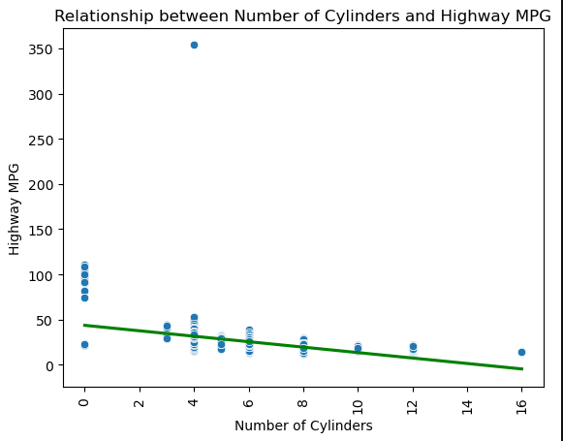
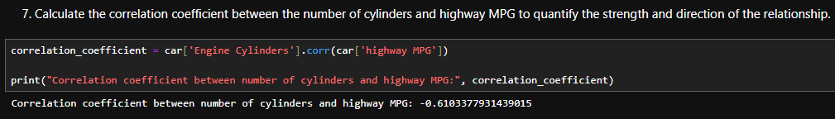

Slide 24
Building dashboard
Task 1: How does the distribution of car prices vary by brand and body style? Consider employing a stacked column chart to illustrate the distribution of car prices across brands and body styles. Enhance interactivity through filters and slicers. Calculate total MSRP for each brand and body style.
Task 2: Which car brands have the highest and lowest average MSRPs, and how does this vary by body style?
A clustered column chart can effectively compare average MSRPs among various car brands and body styles. Calculate average MSRP for each brand and body style.
Task 3: How do different features such as transmission type affect MSRP, and how does this vary by body style?
A scatter plot chart can help visualize the relationship between MSRP and transmission type, with different symbols representing each body style. Calculate average MSRP for each combination of transmission type and body style.

Slide 25
Building dashboard
Task 4: How does the fuel efficiency of cars vary across different body styles and model years?
Utilize a line chart to display the trend of fuel efficiency (MPG) over time for each body style. Calculate average MPG for each combination of body style and model year.
Task 5: How does the car's horsepower, MPG, and price vary across different brands?
Consider a bubble chart to visualize the relationship between horsepower, MPG, and price across different car brands. Assign distinct colors to each brand and label the bubbles with the car model name. Calculate average horsepower, MPG, and MSRP for each car brand.

Slide 26
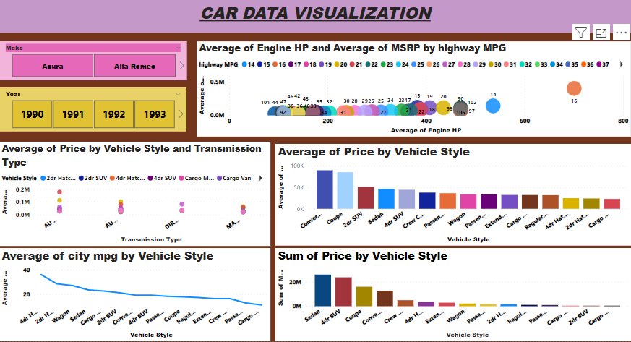
Building dashboard

Slide 27
KEY INSIGHTS

Slide 28
In the crossover market category, a high number of models are built, which means people are liking the crossover category more.
The F150 model has high popularity amongst customers.
The Ford manufacturing company has high popularity amongst customers.
Fewer engine cylinders give more highway MPG, which can attract customers to buy the car.
Sedan, 4-door SUV, and coupe vehicle styles have high popularity and high MRP, which we can use to make the car profitable.
Direct drive and automatic manual transmissions are loved by customers and can be priced high. From insights, we can see that people are continuously buying them despite their high price, which can be used to make our cars profitable.
New models have high MPG due to modifications and improvements made based on customer feedback.
Sedans and hatchbacks give higher average MPG.
Number of doors, city mpg and highway mpg has negative relationship with the price.
Engine HP and Engine cylinders has the strongest positive relationship with the price.

Slide 29
Conclusion

Slide 30
In conclusion, this dataset stands as a valuable asset for data analysts delving into the multifaceted realms of the automotive industry, offering insights pivotal for steering decisions regarding product development, marketing strategies, and pricing tactics.
Through harnessing the insights and functionalities of the provided dashboard, we can navigate toward data-driven choices aimed at optimizing cost structures and bolstering profitability within our car offerings, thereby solidifying our stance in the competitive automotive market.
From the analysis conducted, it becomes evident that sedan-style vehicles from Ford, equipped with either automatic or manual transmissions and boasting an engine horsepower of 250, hold a significant appeal among consumers, as evidenced by their heightened popularity and sales traction. Emulating Ford's successful approach by incorporating similar features into our offerings could pave the path for enhanced market penetration and consumer satisfaction.
Looking ahead, the trajectory of consumer preferences suggests a rising inclination towards vehicles that prioritize fuel efficiency alongside cost-effectiveness. This points towards a potential surge in demand for electric cars boasting high mileage and fewer cylinders, indicative of a shifting paradigm in the automotive landscape.
In essence, by leveraging the insights garnered from this dataset and embracing a forward-thinking approach aligned with emerging consumer trends, we are primed to chart a course towards sustained success and innovation within the ever-evolving automotive sector.

Slide 31
THANK YOU

